Slide 1
Star Trek’s Holodeck
from science fiction to a new reality

Slide 2
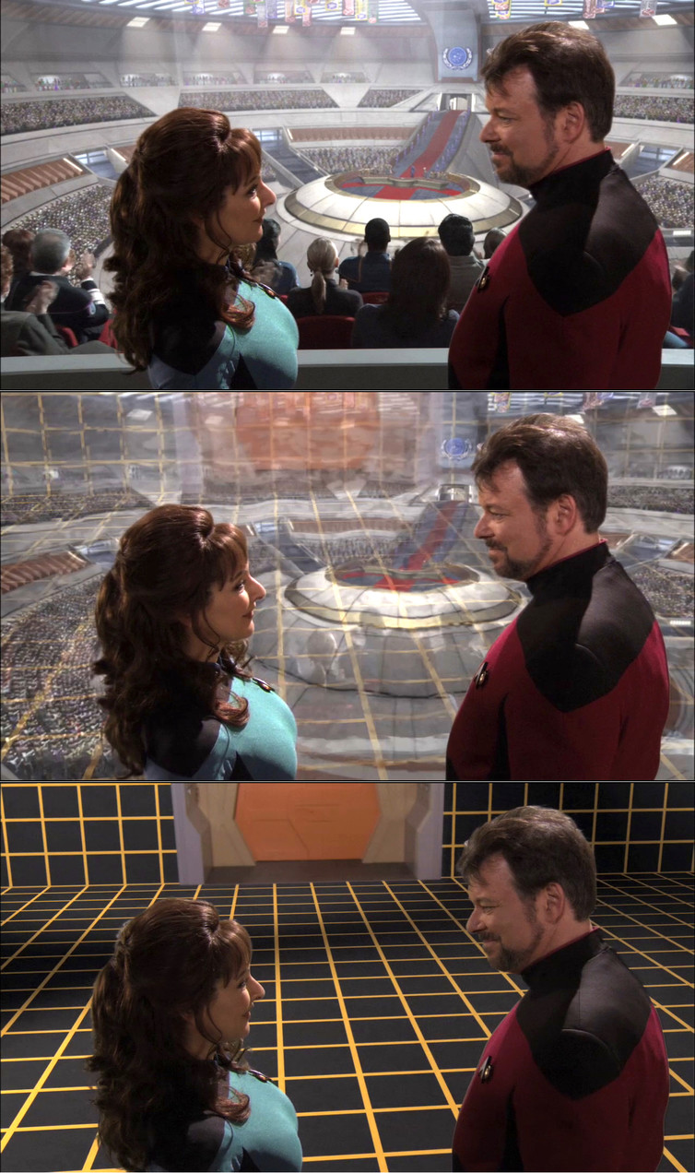
What is the Holodeck?
The Holodeck is a recreation room containing a simulated, alternative version of reality. In the fictional world of Star Trek anyone entering the Holodeck could interact with “solid” props and characters in any scenario based on whatever parameters they programmed.

Slide 3


Slide 4


Slide 5
No real Holodeck yet…
Notes:
While there is still no exact replica of the holodeck yet it has served as an inspiration to a generation or two of computer scientists who have helped spearhead the research into AR, VR, Computer Graphics, and AI.

Slide 6
What do we need
Virtual or simulated setting
Complex and intelligent user interaction

Slide 7
Virtual or simulated setting:
VR:
Generate the realistic images, sounds and other sensations that replicate a real environment or create an imaginary setting.
Simulates a user's physical presence in this environment.
AR
A live direct or indirect view of a physical, real-world environment whose elements are augmented (or supplemented) by computer-generated sensory input such as sound, video, graphics or GPS data.
Interactive and digitally manipulable

Slide 8
Virtual Reality
Used In:
Video games
Military and Space training
Fine Art
Engineering
Cinema and other entertainment
HTC Vive
Oculus Rift
PS VR

Slide 9
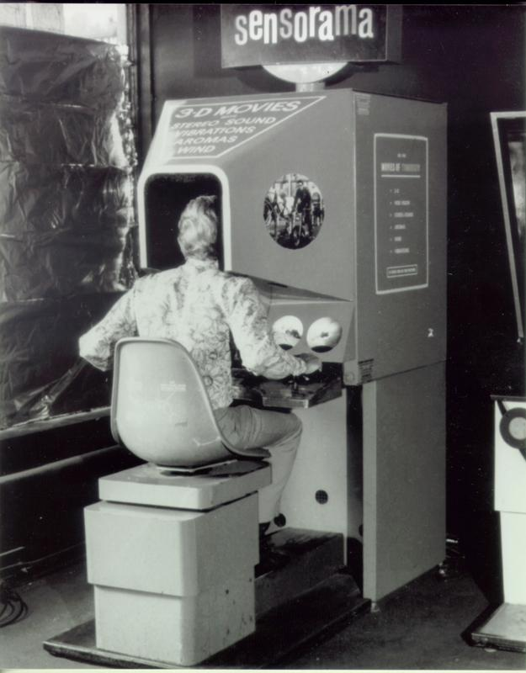
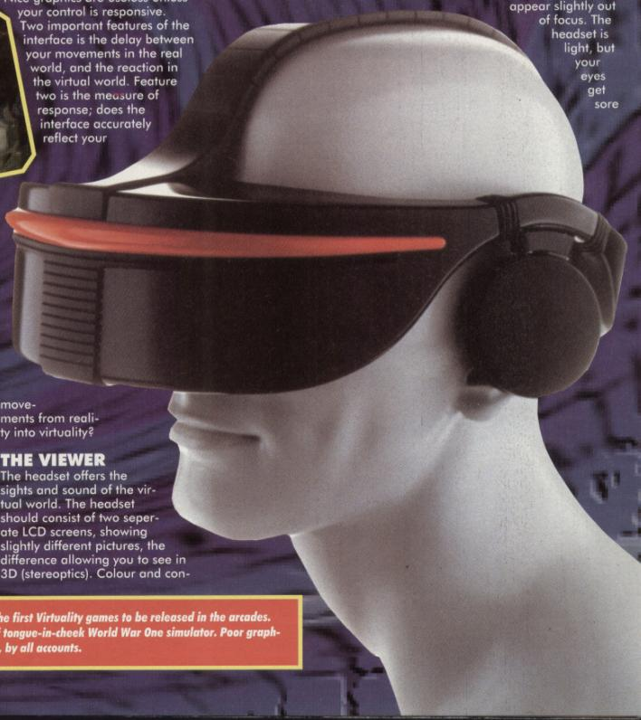
Humble Beginnings
Notes:
1950’s “Sensorama” by French playwright Antonin Artaud. (left)
1990’s “Sega VR” Versions were planned for arcades, Sega Genesis and Saturn, but only the arcade version was released, while the home console versions were cancelled. (right)

Slide 10
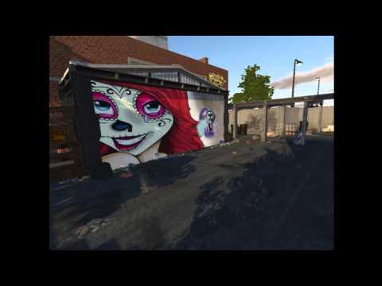
Notes:
Modern VR - HTC Vive

Slide 11
Augmented Reality
Used In:
Visual art
Education
Industrial design
Video games
Military
Navigation
Smartphones
Tablets
Google Glass (HUD)

Slide 12
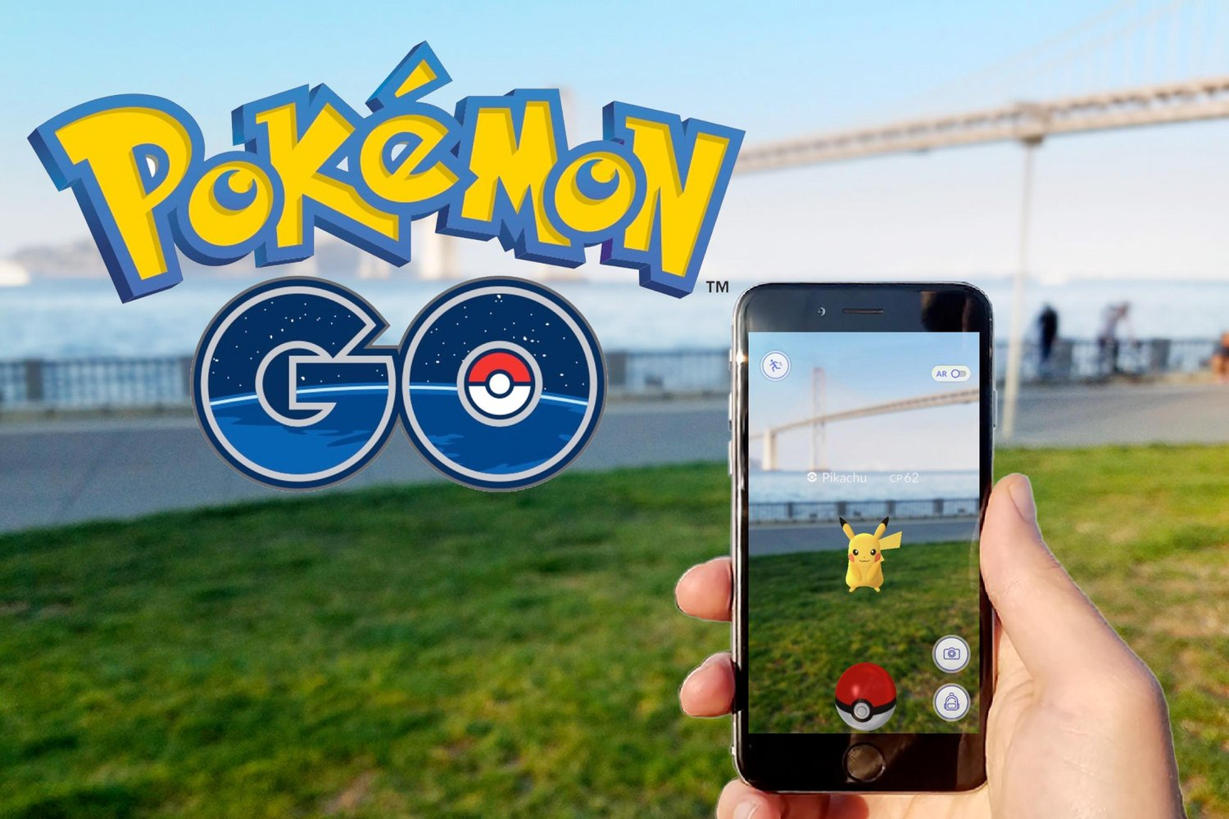
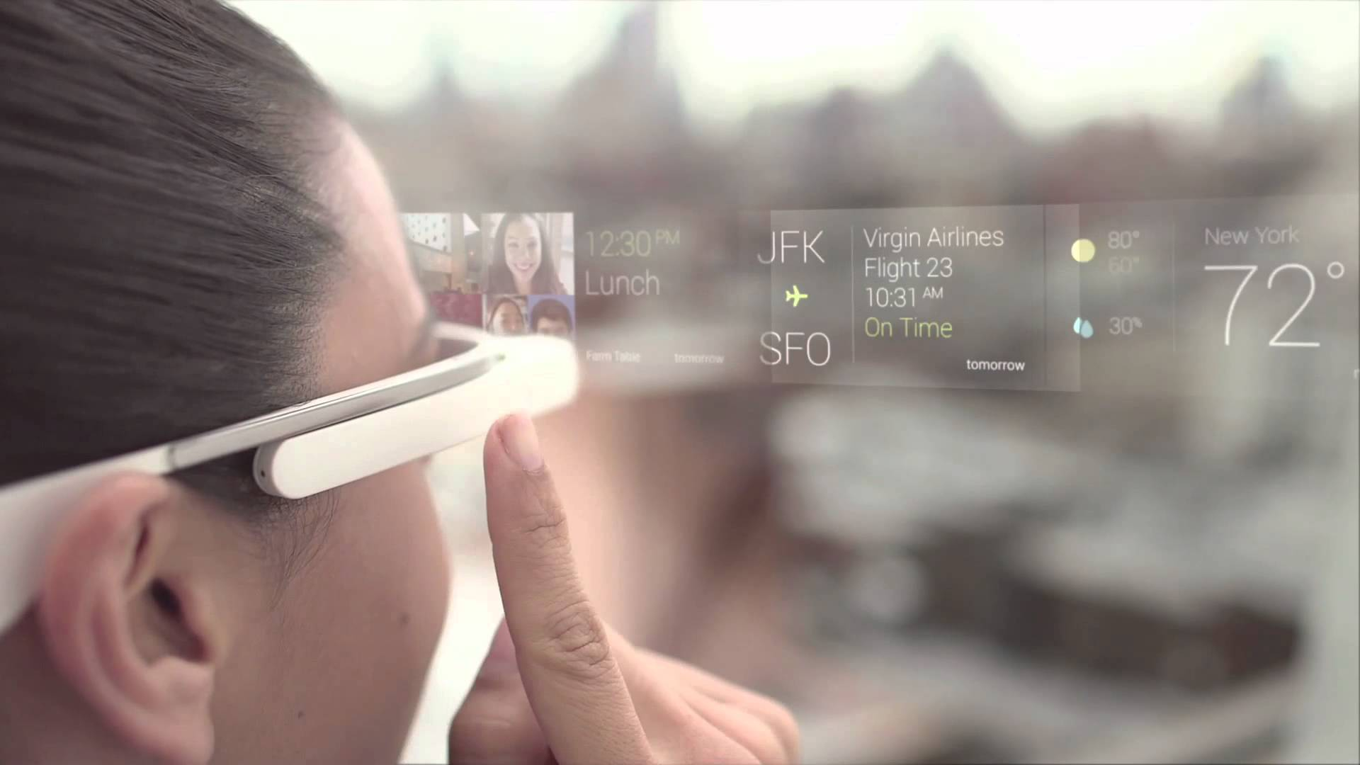
Modern Examples
Notes:
Pokemon go on the left
Mock up of google glass on the right. Mention Military displays and lines that show up the rear view camera when backing up in a newer car

Slide 13
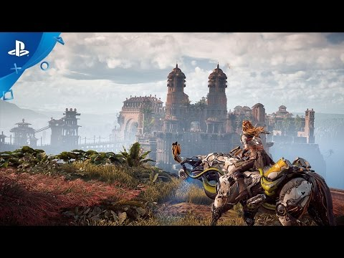
Computer Graphics
Notes:
Computer Graphics has a close relationship to all these technologies as increasing the boundary of realism of computer graphics will make the worlds created more believable and make the experience more immersive.

Slide 14
Complex and intelligent user interaction
AI and Sensing Humans:
Anticipate, read, and understand human intentions and actions
Embed thought within virtual actors to create a realistic characters and believable interactions

Slide 15
Sensing Humans
We already have:
Speech recognition and language translation
Track human gestures or even their full body posture
Accelerometers, gyroscopes, magnetometers, and temperature and pressure sensors.
Apple’s Siri
Microsoft’s Cortana
Google’s Assistant
Microsoft Kinect
Notes:
Take for granted the ability to search for information with speech or to command our mobiles to schedule meetings and appointments.
Track a human body, and the technology is now included in the Hololens as its gesture-recognition component.
The general trend is towards giving humans the ability to communicate using a combination of their body and their voice via hands-free or wearable user interfaces.

Slide 16
Artificial Intelligence
May need a weaker, not fully general form of intelligence
Shortens the time needed to realise the hypothetical Holodeck programs
Predictions about breakthroughs in general artificial intelligence converge to 2040.
machine learning – the art of teaching a machine how to learn to perform a complex task
automated game playing
autonomous car driving
deep learning
Notes:
Biggest Hurdle - defining or providing general human intelligence may prove a very elusive problem for a long time, or indeed forever.
The recent predictions about breakthroughs in general artificial intelligence by experts seem to converge around a date around 2040. This would put the sort of AI required for Holodeck characters somewhat earlier than that.
This coupled with the advanced AR and VR technologies which will be available in 10 or more years or even alternative forms of projections that remove the need for a headset altogether would give us holodeck like expereinces sevral years prior to 2040, making this science ficion a science-nonfiction once and for all.

Slide 17
Refrences
https://theconversation.com/star-treks-holodeck-from-science-fiction-to-a-new-reality-74839
http://www.marxentlabs.com/what-is-virtual-reality-definition-and-examples/
http://archive.ncsa.illinois.edu/Cyberia/VETopLevels/VR.Overview.html
https://web.archive.org/web/20100114191355/http://sega-16.com/feature_page.php?id=5&title=Sega%20VR:%20Great%20Idea%20or%20Wishful%20Thinking
http://memory-alpha.wikia.com/wiki/Holodeck
http://www.newyorker.com/magazine/2015/11/23/doomsday-invention-artificial-intelligence-nick-bostrom

Slide 18
Thank You

